Slide 1

SPD Defense IT 484 ACAS Sela Choup - 201600290
Administrator of CAIS Admission System

Slide 2


ACAS
Administrator of CAIS Admission System

Slide 3

1. Introduction
ACAS is an acronym for Administrator of CAIS Admission System which is named for CAS Online Student Registration.
A replacement to an old tradition school registration system
Effectively manage and organize proper information related to student registration system
Useful in registering students, process application, and sends notifications and updates

Slide 4
1.1 Project Objectives
1.1.1 General Objective
1.1.2 Specific Objective
The project objectives of ACAS is designed to simplify the tasks that has been previously handled by human.
To allow new and transfer students to apply for online registration from distance
To allow existing students enroll for new academic year
Registrar admit students who applied and passed the entrance exam
Send notification or updates
To develop a user module to register, login, apply for registering application form
To develop a student’s profile module to start interacting with the school academic system. With few basic functions such as view profile, reset/change password, update profile, and re-apply for new school year
To develop an administrative registrar user module to manage user, registering student’s application processes, class enrollment process, check student profile, and student enrollment process
To develop an administrator module to create, read, update, and delete users

Slide 5
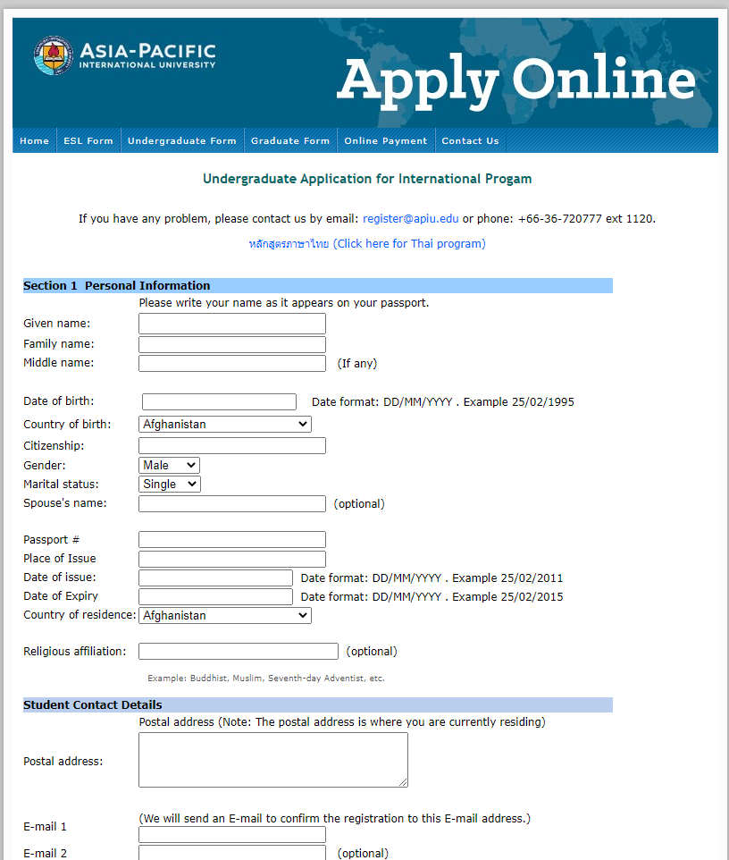
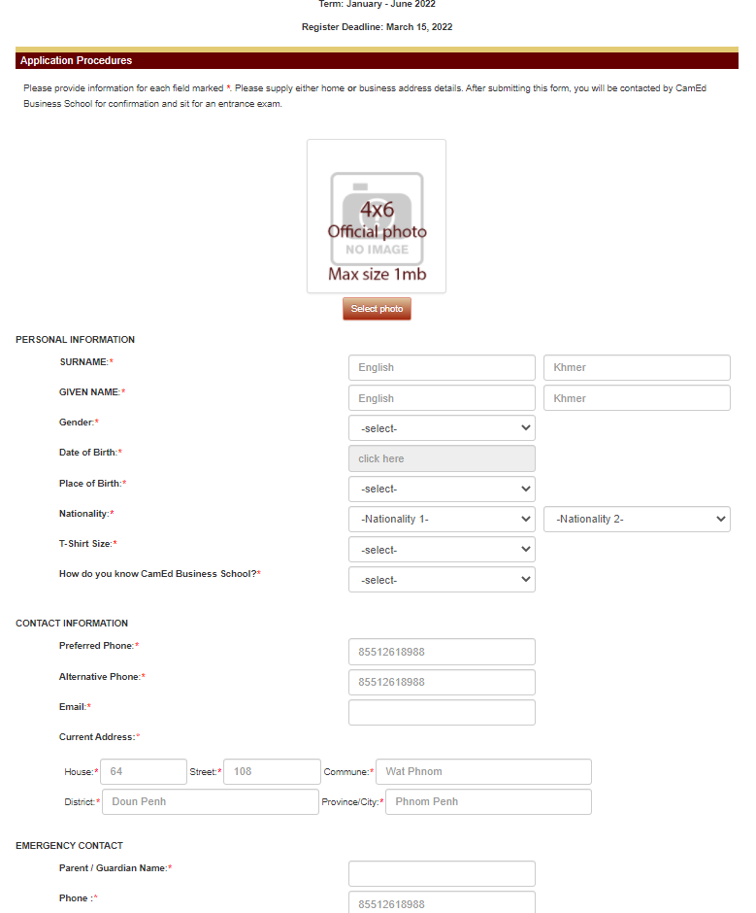
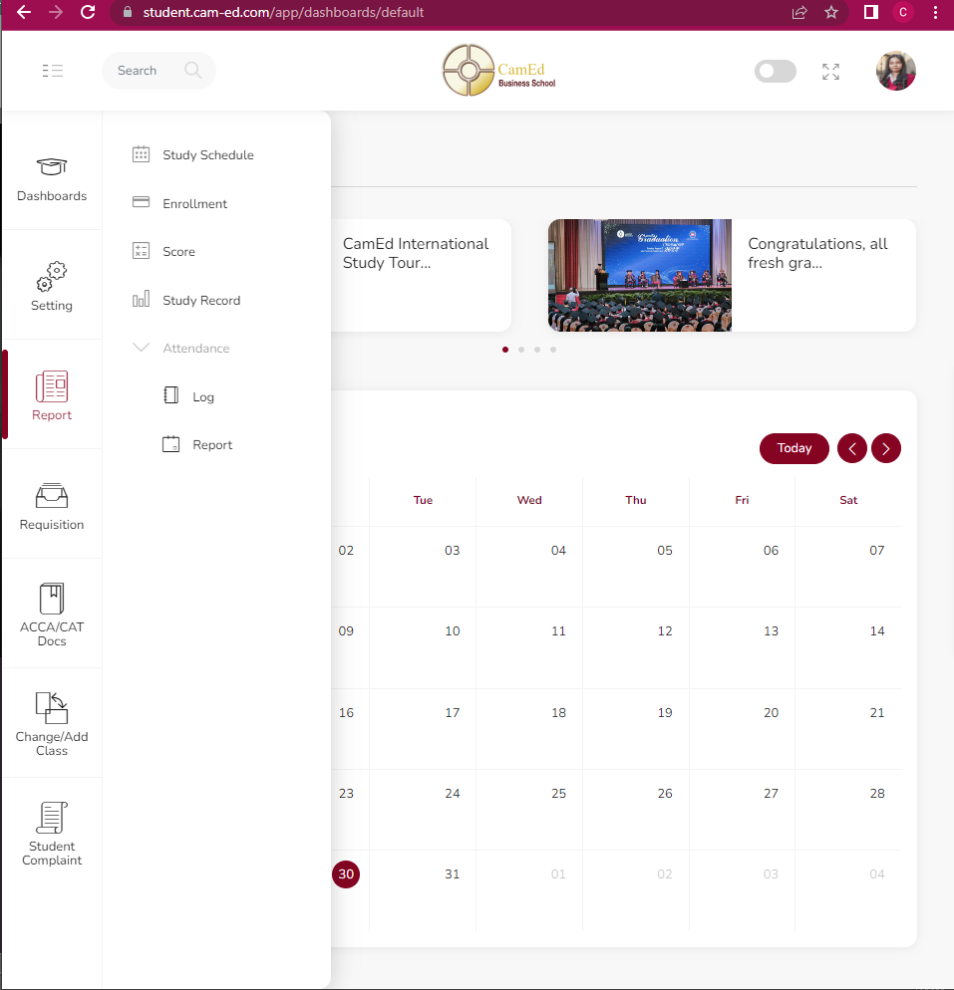
2. Related Works
Online Student Registration system has been widely published and uses in many academic institutions like that of: CamEd, AIMS, and AIU.
Though the method and functionality are different, the similarity between those system and our CASAM will present itself relatively
CamEd Online Portal is an ideal web application for this system

Slide 6
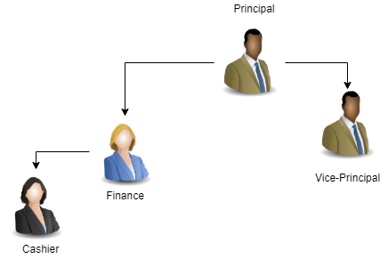
3. Preliminary Investigation
Organization Chart
Company Profile
The main customer of ACAS is likely Cambodia Adventist International School (CAIS), is a private, non-profit co-educational Christian school (k-12) founded and operated by the Seventh-day Adventist Mission in Cambodia.
CAIS is located on the #419, street Rada, Phum Tum Nub, Phnom Penh Thmey, Khan Sen Sok, Phnom Penh, Cambodia. The principle of CAIS is currently named, Mr. Dean Edwardson.
While the vice-principal of CAIS, Mr. Sopheak Meas is the one whom I have contacted during the preliminary process has phone contact as +855 12 946 041 along with an email address: sopheakmeas@yahoo.com.
Statement of the Mission & Goal
Mission Statement: To provide academic excellence in a Christ-filled environment that encourages the love of God, serving others, and self-respect.
Vision Statement: We believe that education should train the mind, body, and the soul of all our students. True education will make the students a better citizen for this world and the world to come.

Slide 7

3.4 Project Request
During the COVID-19 pandemic infiltration, the school encountered problem with student registration, so below are the key functions in their request:
To apply for new student or transfer new student
To enroll existing students
To view the list of students application form
To notify students about new updates
To admit student after being accepted

Slide 8
3.5 Description of the Problem
With a proper online student registration system, students and guardian will be able to access and apply from anywhere at anytime.
CAIS lack a proper centralize system
Still relying on the manual log book and registration form on paper that could be lost or forget by administrator
Inefficiently, student registration still required a face-to-face paper-based registration or enrollment of existing students
Student records are not effectively updated

Slide 9
3.6 Project Scope and Constraints
Proposed Solution are found in these functional requirements: :
1
2
3
Registrar Management
Student Management
Admin Module
Register a user account
Login
Manage User Account
Management Enrollment Process
Registration
Class Enrollment
Student/Staff Enrollment
Send Updates to Parents
Receive Notification/Updates
View Menu page
Enrollment for existing student Account Setting
Update profile
Logout
Login and register users
View Profile and Change Password
Create, Update, Delete, and List users

Slide 10

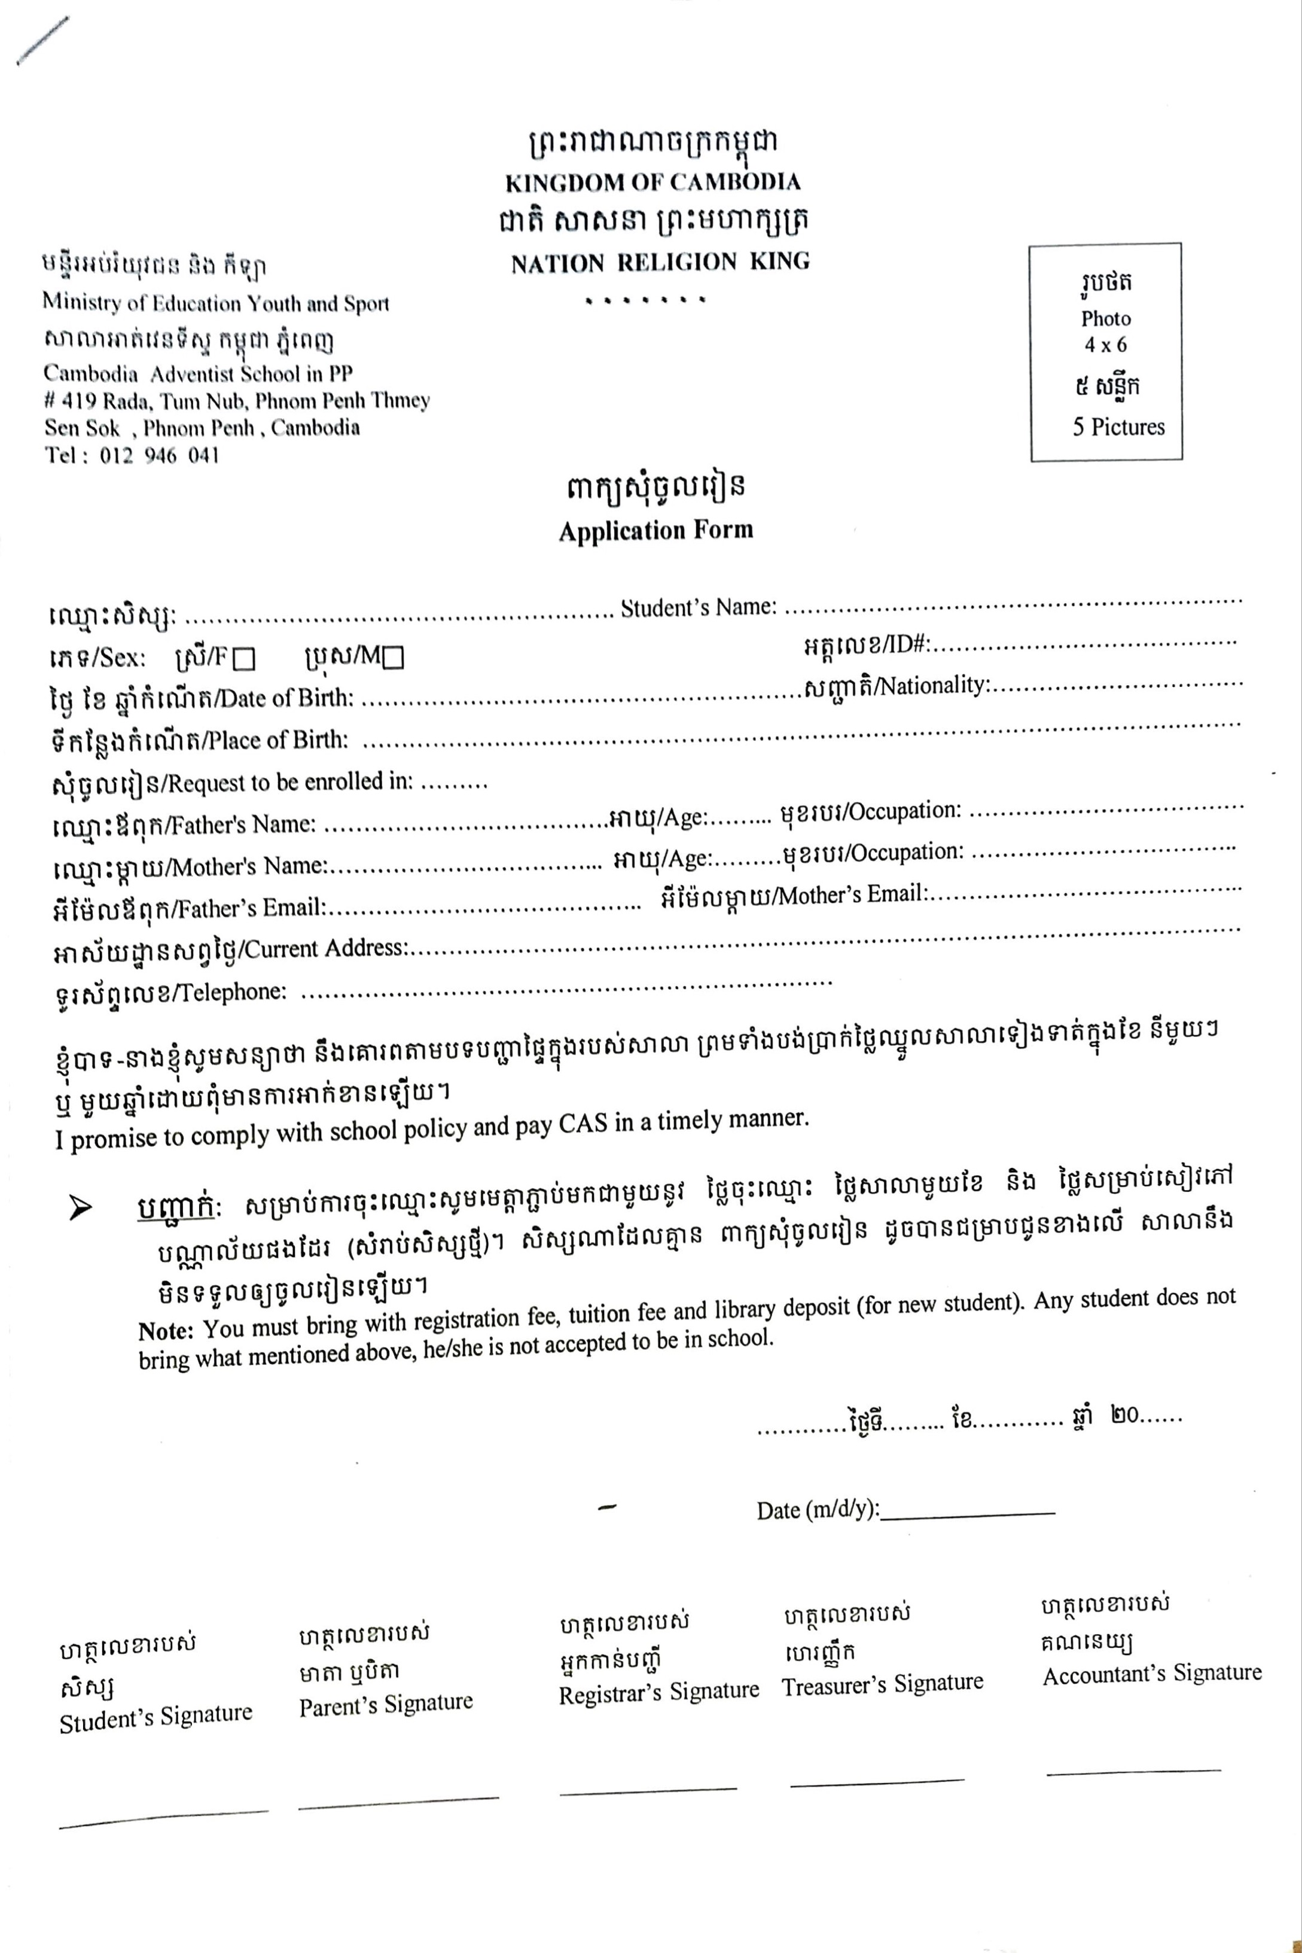

3.6 Project Scope and Constraint Cont.
Non-Functional Requirements
A running server at CAIS
A running CAIS management system
CAIS Domain name
A minimum built server
UPS
RAM 4 GB
SSD 500 GB
Fast Ethernet cable connected to a Gigabyte switch
Processor – Intel Core i7 or Intel Xeon

Slide 11
3.7 Expected Business Benefits
To solve the current problems and replace those traditional paperwork with new online registration system, ACAS increase efficiency in registering students from anywhere at anytime and to make a better communication.
Users or Guardians
Reduce the cost and time to travel to do a half-day paperwork
Avoid close contacts during COVID-19 pandemic
Provide comfortability when doing a registration process
School Admin
Avoid close contacts
Application Form automatically stored after
Reduce the busy-tight schedule of student registration
Able to respond and make a better communication via email or Contact Us

Slide 12
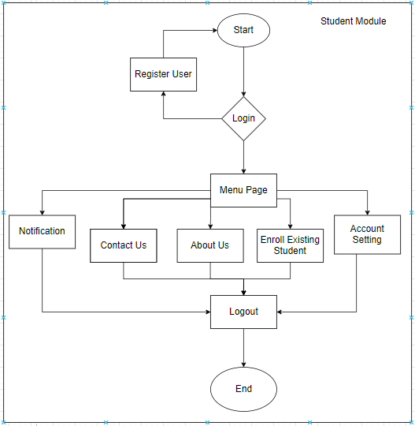
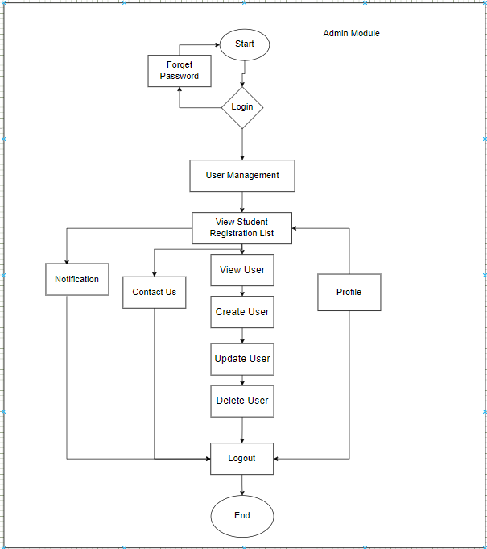
Business Process
Student Module
Admin Module

Slide 13
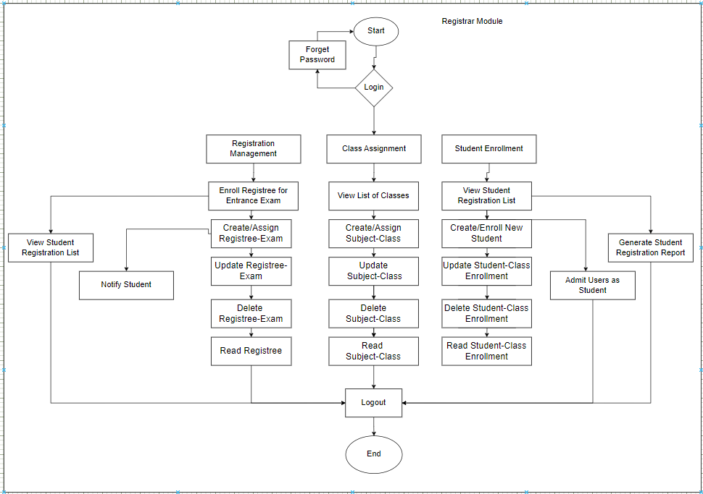
Business Process
Registrar Module

Slide 14
3.8 Expected System Capabilities
 | User Management | Notify Student via E-mail | Register New Application Form | Enroll Existing Student | View Student Registration | Admit User into Student Database | View Student Registration Report
Administrator | Read & Write | None | None | None | None | None | None
Registrar | Read & Write | Read & Write | Read & Write | Read & Write | Read & Write | Read & Write | Read & Write
Student | None | Read | Read & Write | None | None | None | None
User | None | None | Read & Write | None | None | None | None

Slide 15
3.9 Development Environment: SDLC – Waterfall Model
1. Planning
2. Analysis
3. Design
4. Implementation
5. Testing
6. Maintenance
Development
Staging
Production

Slide 16
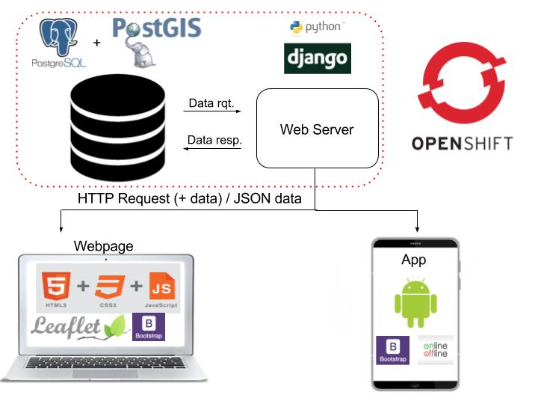





3.10 Feasible Study – Technical Feasibility

Slide 17
3.10 Feasible Study
A study to evaluate feasibility of proposed project or system. It is a measure of the software product in terms of how much beneficial development will it be for the organization.
1
2
3
Technical Feasibility
Legal Feasibility
Operational Feasibility
Server-side web prog: Python Full Stack (Django framework, JSON, JavaScript, HTML, CSS, Bootstrap 5)
MySQL server or MySQL Workbench for database for the long run
Web server (Apache)
User consent on privacy and right to store input data
Data encryption through harsh password
Includes data protection acts or social media law, user authentication and copyright
With documentation (user guides or manual) given differently to:
Developer (documentation)
Clients: Users/Students (video tutorial, how-to-videos or user guide)
Expected to be able to operate within an hour or less for client and less than a day for developer

Slide 18
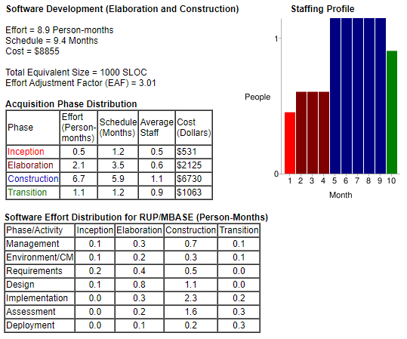
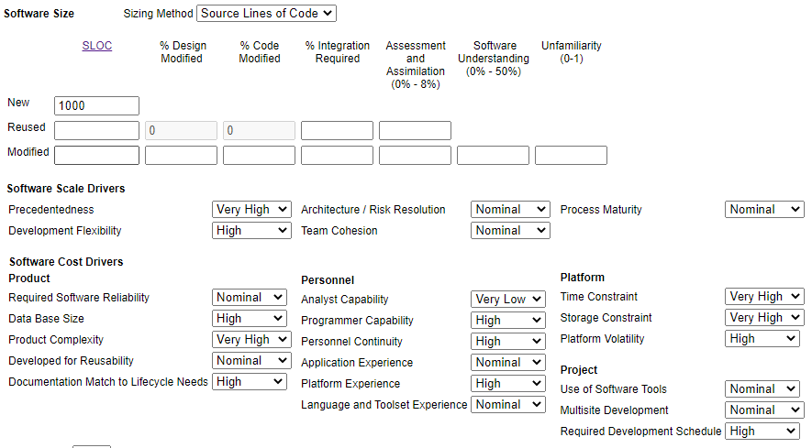
3.10.4 Schedule Feasibility
The project scheduling
Start Time: Senior Project 1 started on January, which is the 1st semester of the project
Expected to End: Senior Project 2 should probably be ended at the end of the summer season or probably 2nd semester of the project that has been assigned

Slide 19

3.10.5 Financial Feasibility
The study of economic cost
Professionally, the estimate cost the overall project could be more interestingly pricy if were to apply the calculation of COCOMO II.
However, in reality, the developer does not have much expenses to develop this project. The developer uses open-source tools to develop. Being one of the school employee is considered a part-time task to fulfill this online registration system construction.

Slide 20
3.11 Planning
Gantt Chart
Start Time: SP1-Jan
Expected to End: SP2-Aug
Planning Process | SP1-Jan | SP1-Feb | SP1-Mar | SP1-Aprl | SP1-May | SP2-June | SP2-July | SP2-Aug
Requirement Planning
Development
Designing Algorithm
Build Front-End
Built Back-End
Testing I
Changes (If any)
Testing II
Changes (if any)
Deployment

Slide 21
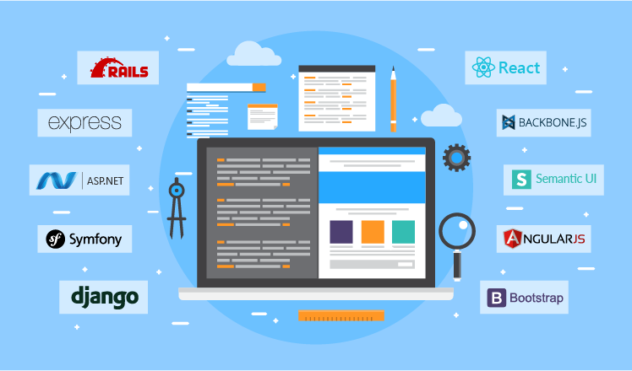
4. Analysis and Design
Introduction
According to the preliminary investigation of this project mentioned earlier, the customer of this project is requesting for online registration web based application. A system that is always available for whoever, whenever, or wherever the users are as long as there’s internet connectivity

Slide 22
Risk Analysis
Risk Table | Risk Category | Probability | Impact (1-4) | RMMM
Developer’s Individual Problem | Schedule Risk | 15% | 2 | PR01
PC crash | Technical Risk | 10% | 1 | PR02
Change of Project’s scope | Programmatic Risks | 15% | 2 | PR03
Lose backup file | Technical Risk | 10% | 1 | PR04

Slide 23
Risk Analysis
Risk information sheet
Risk ID: PR01 | Category: Schedule Risk | Probability: 15% | Impact: 2
Description: The developer might encounter some problems as such the quality of a programmer health will determine the success of his project or that he/she will encounter extra workloads while working on a certain project. The skills of a developer will also determine the success of this project.
Mitigation/Monitoring: The developer will take care of his own health and carefully be cautious about his own safety.
Management/contingency plan/trigger: The developer will need to learn how to be healthy physically, mentally, and emotionally so that he will remain in a good well-being.
Risk information sheet
Risk ID: PR03 | Category: Schedule Risk | Probability: 15% | Impact: 2
Description: The developer might get carried away with his personal or professional interest while working on this certain project. There are many external factors that could hinder the progress of this project development.
Mitigation/Monitoring: The developer must be strict on his project scheduling and planning. He should’ve stay tune to his project deadline.
Management/contingency plan/trigger: Try to do self-reflection once a week to follow up your project development and its progress.
Risk information sheet
Risk ID: PR02 | Category: Schedule Risk | Probability: 10% | Impact: 1
Description: The developer might face severe technical problem due to the damages of computer/PC/laptop. The programmer’s individual carefulness with the PC is likely impacting the development of the project.
Mitigation/Monitoring: The developer will take care of his own computer/PC and carefully be cautious about his data safety.
Management/contingency plan/trigger: The developer will need to learn how to backup and safely protect his PC/laptop for his security reasons.
Risk information sheet
Risk ID: PR04 | Category: Operational Risk | Probability: 10% | Impact: 1
Description: The developer might be able to lose backup when there are many suspicious activities that might harm the health of the PC
Mitigation/Monitoring: The developer will need to start taking care of his personal data, backups, and privacy more professionally
Management/contingency plan/trigger: The developer must learn to use as much as possible about the technologies that’s essentially help the current working project and developing all the possible best result at the same time.

Slide 24

4.3.1 Conduct of Analysis
The initial meeting with the client, Mr. Sopheak was actually on way back to end-June of 2021, it was then that we had discussed about the problems and what can be the solution.
However, on January 7th of 2022, a proper meeting was conducted. I interviewed about the cases related to school registration system and how he wanted for his new feature.
I presented to him some features of the related work from CamEd online registration system, SARRA online registration system and AIMS online registration system.
We decided to start simple and grow better later.

Slide 25
4.3 Business Analysis and Design
4.3.2 User Requirements
1
2
3
Input Requirements
Output Requirements
Process Requirements
Data capture procedures are basically:
Keyboard input such as texts, numbers, special characters or pictures
They are also some personal information about the student and their parent/guardian
Output requirements specify the type of layout and frequency of the reports generated by the administrative registrar to be produced.
Process requirement specify the processing info of data input to output.

Slide 26
4.3 Business Analysis and Design
4.3.2 User Requirements
4
5
6
Performance Requirements
Control Requirements
User Training Requirements
The server will be hosting 24/7 throughout the weeks and month; therefore a PC that is durable and reliable enough to handle this hosting will be at the least requirement of:
UPS
RAM 4 GB
SSD 500 GB
Fast Ethernet cable connected to a Gigabyte switch
Processor – Intel Core i7 or Intel Xeon
Control requirement will be shown in the next slide, it’ll specify the access of users, roles, and their functionality
Documentation will be provided as a resource to aid the clients with all the necessary information given in the form of how-to-videos or tutorials.
For developers, documentation of the whole-built system is what is required for further development or modification

Slide 27
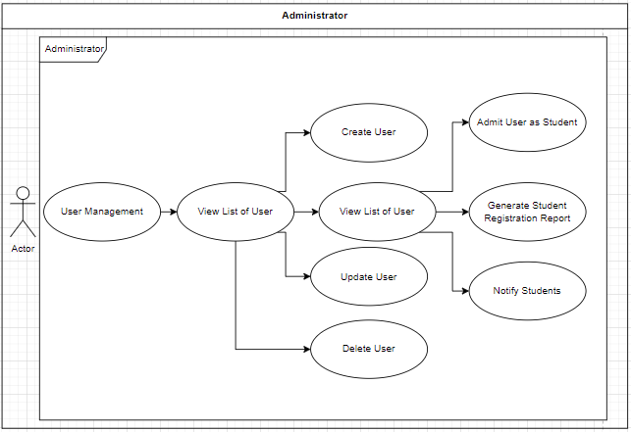
USE CASE 1
Administrator
Admin User are able to CRUD all users in the system.

Slide 28
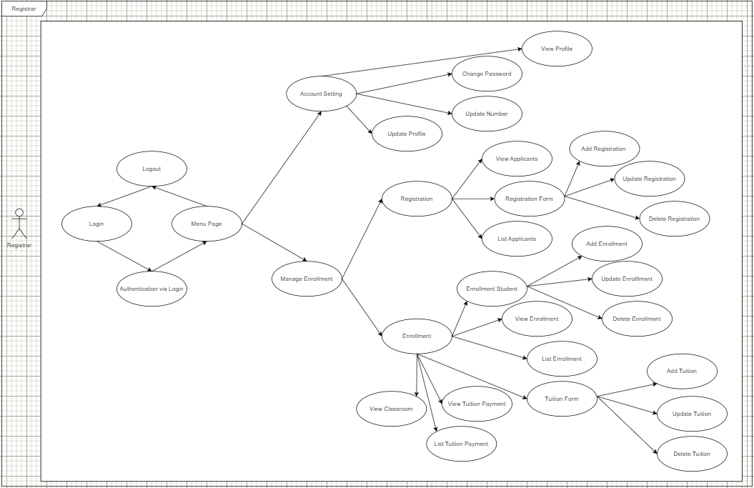
USE CASE 1I
Registrar
Registrar will be able to have control over all this admission information in the system

Slide 29
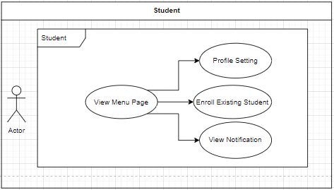
USE CASE 1II
Student
Students User are able to view the useful information in the system

Slide 30
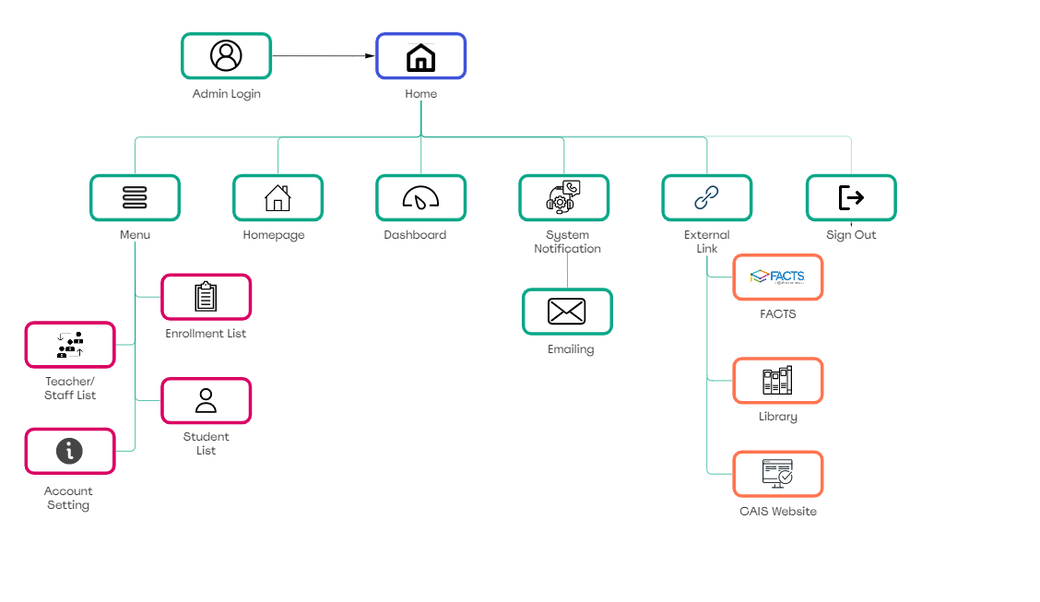
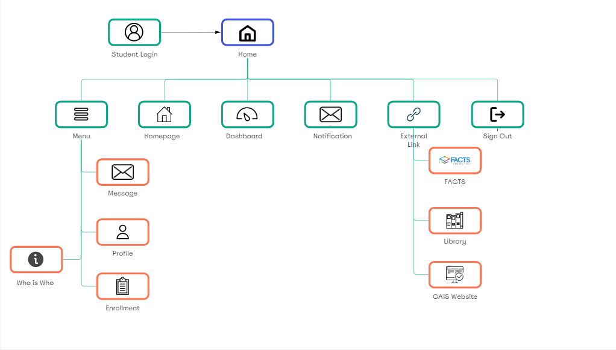
USERFLOW
Admin User Flow
Registrar User Flow
Student User Flow
User

Slide 31
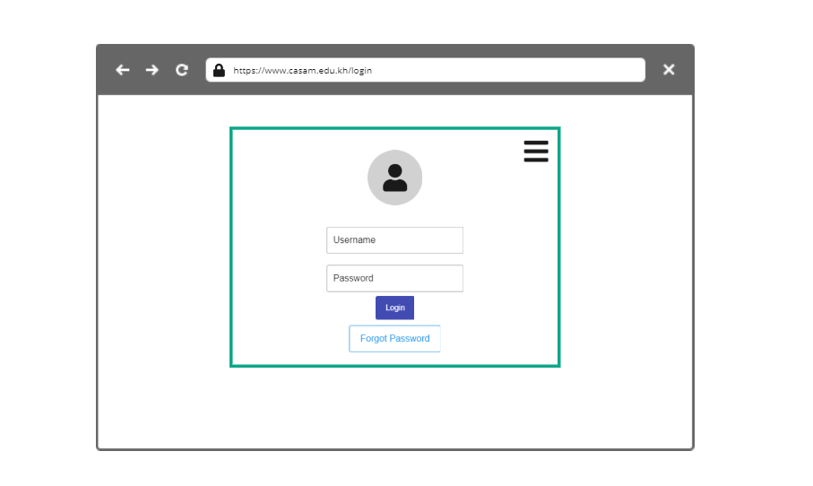
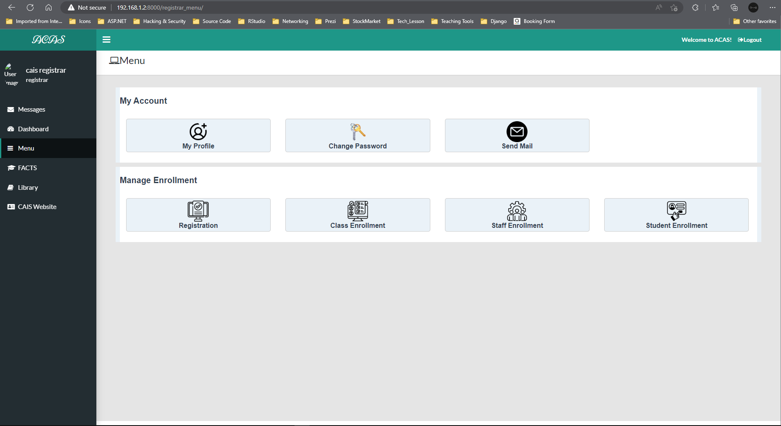
Login Page
Menu Page

Slide 32
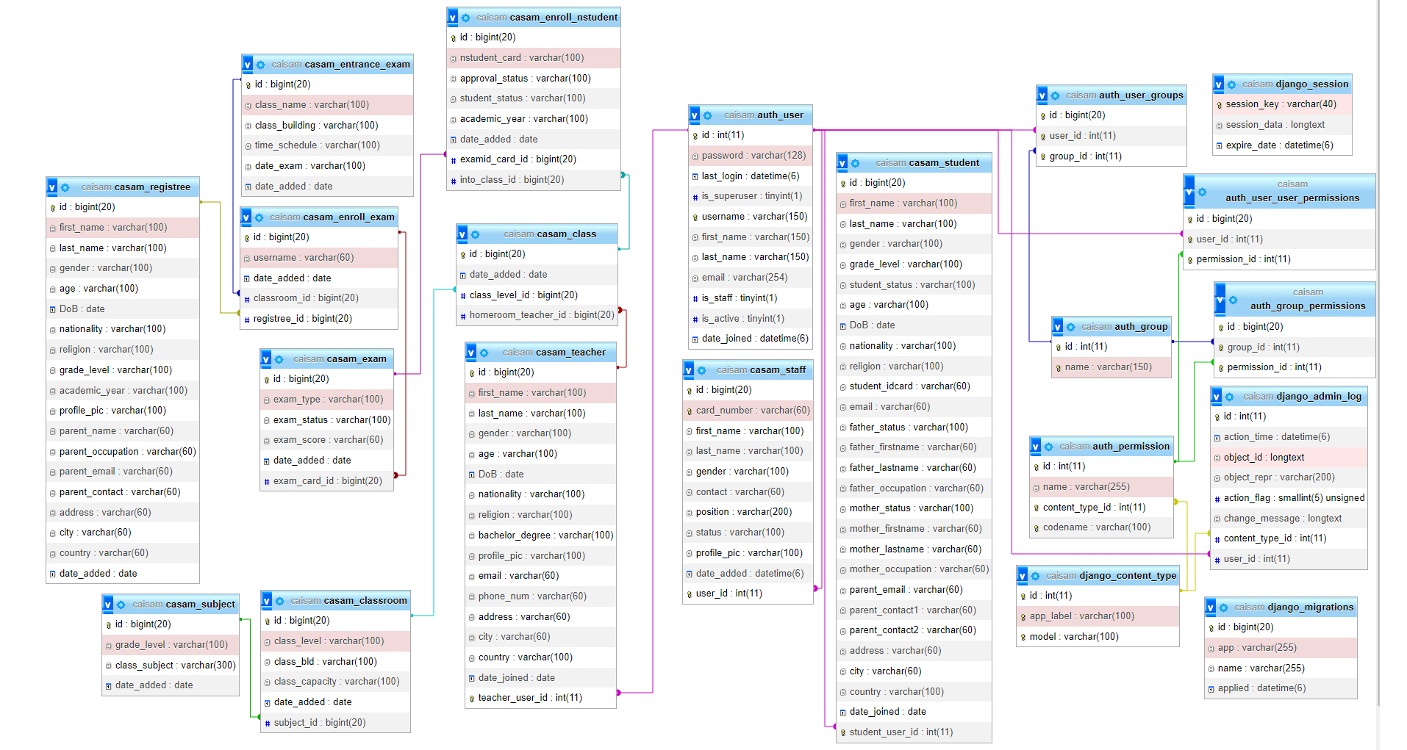
Database Diagram

Slide 33

4.3.3 Infrastructure Analysis
Hardware Required vs Available
Software Required vs Available
Hardware required | Hardware available
PC to host the server | PC to host the server
Software required | Software Available
Apache Web Server | Apache Web Server
Django Framework | Django Framework
MySQL | MySQL
Bootstrap 5 | Bootstrap 5
JavaScript, HTML, CSS | JavaScript, HTML, CSS

Slide 34
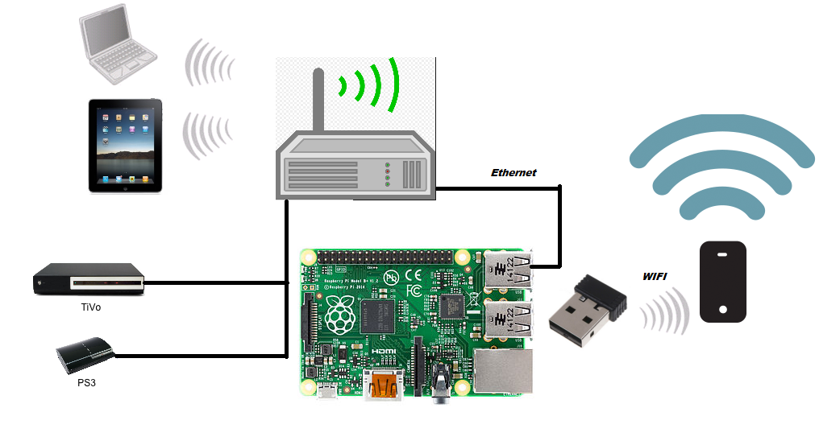

Network Analysis
Network Connectivity
As long as our implementation is successful, we will start deploying our server into CAIS domain name. As of right now, the implementation and testing phase are locally run by localhost

Slide 35
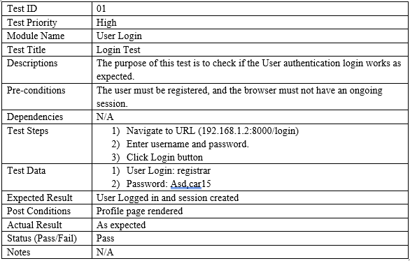
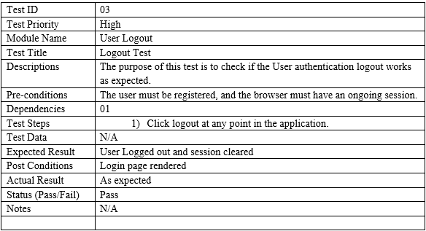
Unit Tests
User Login
User Logout

Slide 36
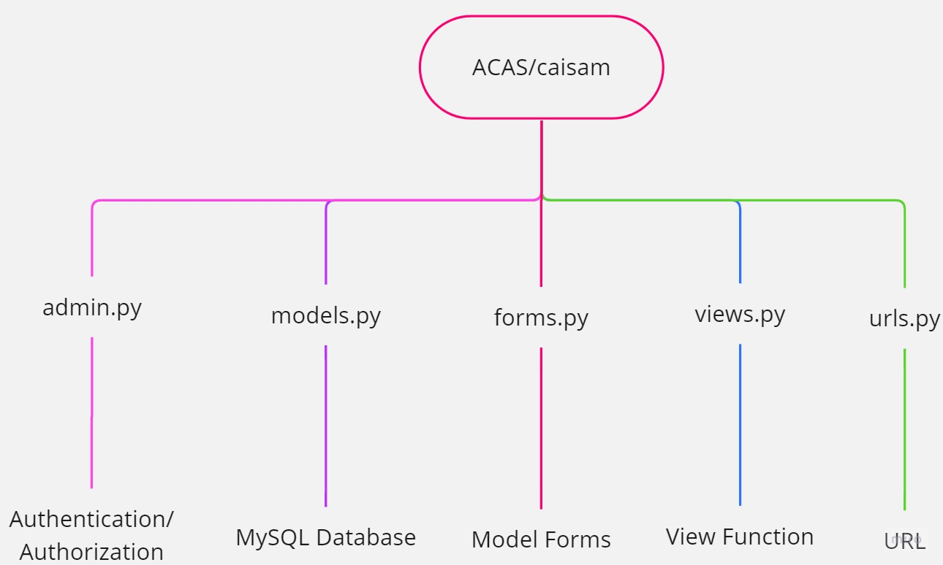
Integration Test
Hierarchy level of Integration Test
The developer chose to use the top-down integration test method. This involves the testing from the highest-level modules and testing their subsequent lower-level modules

Slide 37
Conclusion
Debugging
Code Development
Time Management
There are many attempts, backups, recoveries, and re-installation of these whole process just for developers to build up a familiarity with the Django framework, its relativity syntax and functional algorithms
Education system are springing world-widely across the globe, admission system is not the first breakthrough in this case. There are many types of school system that are relatively available online including the sales of these web, mobile, desktop, and server application.
It is hard to stay focus when you’re doing many things at the same time or regardless of prioritization

Slide 38





Future Works
Better GUI
Highest form of security
Demand functionality
more responsive user-friendly screening, simplicity display, and the clarity of object like texts and buttons
on data encryption, account management, sensitive information, and cashflow for tuition payment
grading system, attendance check-in/out, classroom management, online transaction, finance report, class materials, message center
the integration of System
development on technology
Library management system, Sun Plus, and LMS for School Learning Management System
Mobile App, Desktop App, and the up-running VMware for cloud computing

Slide 39
Please STAY Tune!
It’s time for Module Presentation and Code Documentation!!!
Sela Choup
Phone:
+855 96 560 2640
Email:
selachoub015@gmail.com
References
:
CamEd. (2021). CamEd Business School. Retrieved from https://cam-ed.com/online-portal/: https://cam-ed.com/online-portal/

